Slide 1
DBE INDUSTRY UPDATE MEETING
APRIL 11 & 25, 2025 NDDOT BID OPENING

Slide 2
MARCH 14, 2025 Bid Opening Update
All projects awarded except for 24228 (pending county concurrence)
All DBE Goals Met/No RGN DBE Participation
Overall DBE Participation 7.27% adjusted for FAS
Total to DBEs: $3,355,276
$2,627,119 to DBE Subcontractors – 78.30%
$357,461 to DBE Trucking – 10.65%
$370,696 to DBE Distributors – 11.05%

Slide 3
March 21, 2025 Bid Opening Update
All projects awarded except 23800, 23916 & 23921 (pending city concurrence)
All DBE Goals Met with $83,932 in RGN Participation
Overall DBE Participation 1.51% adjusted for FAS
Total to DBEs: $650,098
$136,873 to DBE Subcontractors – 21.05%
$36,450 to DBE Trucking – 5.61%
$470,705 to DBE Distributors – 72.41%
$6,070 to DBE Suppliers – 0.93%

Slide 4
APRIL 11, 2025 Bid Opening
24 Federal Aid Projects
24555 is NOT Federally Funded – No DBE requirements apply
8 Projects with DBE Goals
JOB NUMBER | DBE GOAL
22048 | 1.50%
22597 | 4.00%
22640 | 9.50%
23704 | 1.50%
23913 | 5.00%
23967 | 4.50%
24039 | 2.50%
24050 | 3.50%

Slide 5
APRIL 25, 2025 Bid Opening
7 Federal Aid Projects
24285 is NOT Federally Funded – No DBE requirements apply
2 Projects with DBE Goals
JOB NUMBER | DBE GOAL
24097 | 2.00%
24246 | 1.50%

Slide 6
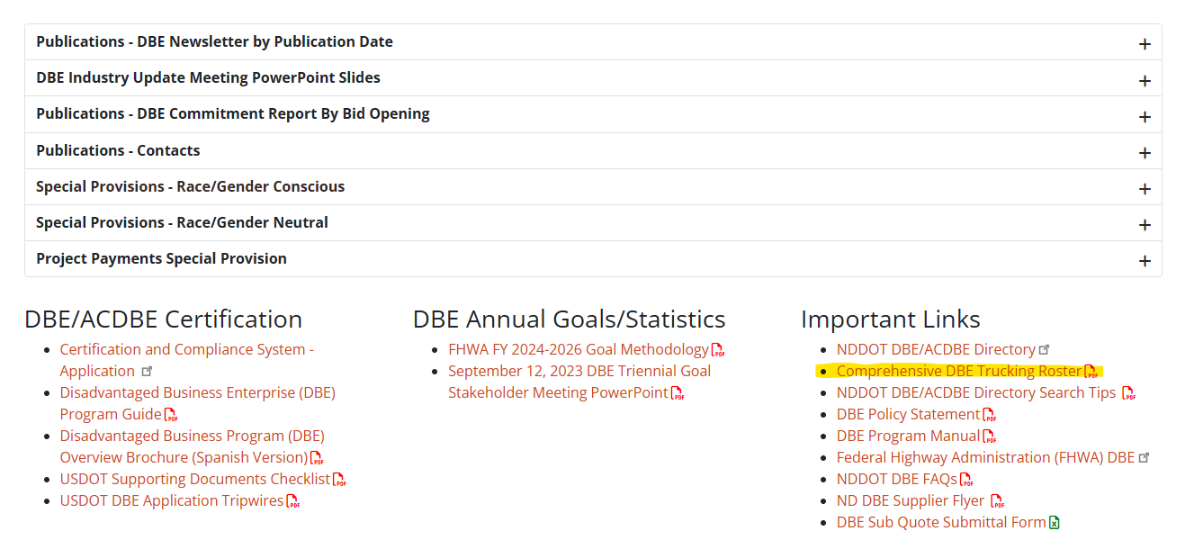
COMPREHENSIVE DBE TRUCKING ROSTER
https://www.dot.nd.gov/sites/www/files/documents/civil-rights/Comprehensive-DBE-Trucking-Roster.pdf

Slide 7
VARIOUS INFORMATION
Only available via email April 17th through May 2nd – may have delayed responses
Alternate Contact: Ramona Bernard 701-328-2576 rbernard@nd.gov
DBEs that repetitively fail to send quotes to subquotes@nd.gov prior to the bid opening will be found in non-compliance
DBE 101 Training for Primes in the works – will be a recorded training posted to DBE website to view at any time
Tentative dates for 1:1 Ratio DBE Trucking Training will be August & September (multiple opportunities will be available)

Slide 8
DBE DIRECTORY UPDATES
New Highway Construction:
Skyview Construction – Summit, SD – Certified 4/1/2025
Removals:
Country Truckin’ – Culbertson, MT – 3/19/2025
Praise & Favor Trucking – Horace, ND – 3/19/2025
Tiguem Trucking – Aurora, SD – 3/19/2025
Certification Updates:
None
DBEs should regularly check their DBE Directory Listing to make sure all information is up to date and correct. If anything is incorrect, please contact Jessica Stadick-Feist at jstadick@nd.gov
Updates or changes to current certifications that could impact a DBEs availability to quote additional items or change DBE type (i.e. from Distributor to Supplier) are not processed the week of a bid opening

Slide 9
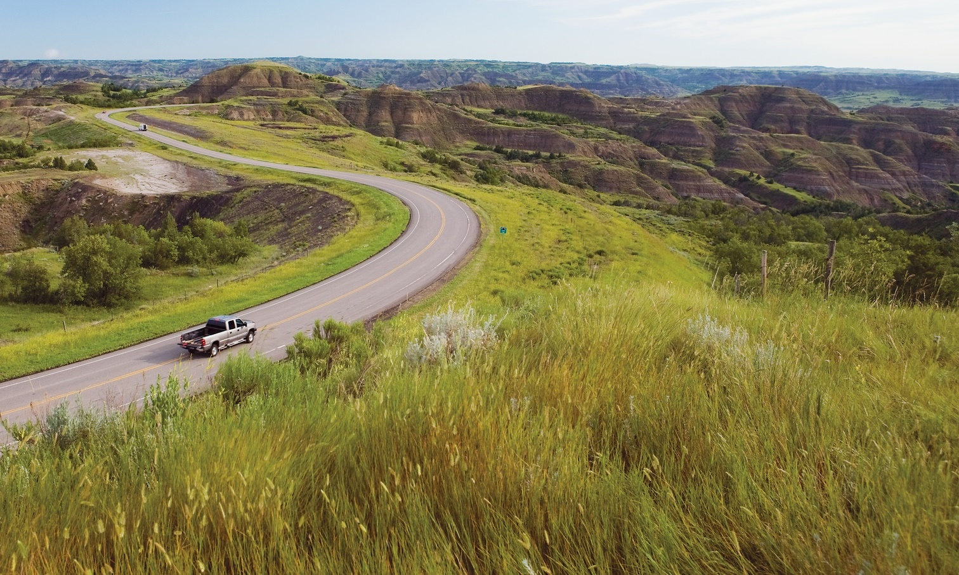
INFRASTRUCTURE FUNDING
QUESTIONS?
Bill Panos, Director

